Slide 1
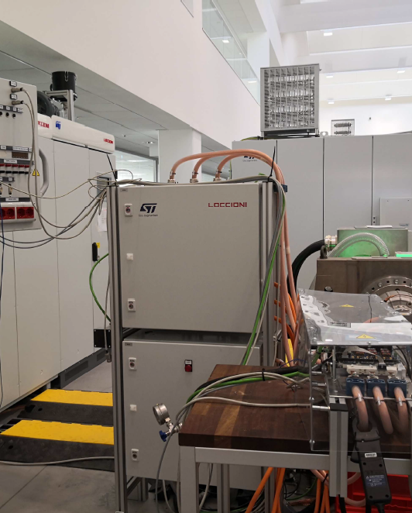
CAN Interface for Automation of the Dyno Bench
Michele IMBARRATO
SRA LAB

Slide 2
Index of topics
AGENDA
01
Objective of the work
05
02
DBC file: structure and updates
Validation of the existing CAN library
06
03
Vector CANalyzer and GUI integration
Implemented changes and developments
07
04
Conclusions and results
Advanced validation and debugging

Slide 3
Objective of the work
OBJECTIVE
The aim of the project is to develop a CAN interface to automate the communication between the microcontroller (uC) and the Dyno bench software.
1
2
3
Library validation
Edit DBC file
Creation of control GUI
Verifying and Correcting the Existing SR5E1 CAN Library.
Modification of the DBC file by adding new CAN messages.
Development of the control and monitoring graphical interface (GUI).

Slide 4
Validation of existing CAN library

Slide 5
Architecture and offset rule
CAN LIBRARY
The initial library was designed to interface the test bench (Dyno bench) with the firmware of the Stellar-E microcontroller via CAN bus. It adopts the Dyno-to-Dishwasher (DYNO2DW) protocol: a translation function that converts the CAN commands of the bench into the format of the ST Motor Control Dishwasher protocol.
Dyno Bench
DYNO2DW
(translation)
Firmware Stellar-E
(ST MC Protocol)
+0x30 Offset
+0x40 Offset
Input commands from the Dyno bench to the inverter.
Outgoing Diagnostics to the Dyno bench.

Slide 6
Periodic diagnostics— Send_Status
CAN LIBRARY
To allow the Dyno bench to monitor the status of the inverter in real time, the library integrates a periodic diagnostic function that sends a stack of messages every 100 ms.
#define CAN_NUM_MSG 10
uint8_t msg_tx_diag_can[CAN_NUM_MSG] = {
MC_PROTOCOL_REG_UNDEFINED, // counter, update 100ms
MC_PROTOCOL_REG_SPEED_REF,
MC_PROTOCOL_REG_TORQUE_REF,
MC_PROTOCOL_REG_FLUX_REF,
MC_PROTOCOL_REG_BUS_VOLTAGE,
MC_PROTOCOL_REG_HEATS_TEMP,
10
MC_PROTOCOL_REG_SPEED_MEAS,
100 ms
MC_PROTOCOL_REG_TORQUE_MEAS,
MC_PROTOCOL_REG_FLUX_MEAS,
MC_PROTOCOL_REG_STATUS
Diagnostic Registers
Sending interval
};
uint8_t Send_Status(MCP_Handle_t *pHandle) {
if (FCP_TRANSFER_IDLE == pHandle->pFCP->TxFrameState) {
for (i = 0; i < CAN_NUM_MSG; i++) {
It iterates over the 10 registers and reads their current value
support_buffer = UI_GetReg(&pHandle->_Super, Register, NULL);
}
Packages the data in the CAN frame buffer
pHandle->pFCP->TxFrame.Code = code;
pHandle->pFCP->TxFrame.Size = size;
Triggers transmission via dedicated IRQ handler
DBCCAN_TX_IRQ_Handler(pHandle->pFCP);
}
}

Slide 7
Transmission and Reception Mechanisms
CAN LIBRARY
Transmission
Reception
Send_Status Function
DYNO2DWProtocol function (from ISR IRQ_CAN1_LINE0_HANDLER)
Reads register value with UI_GetReg()
Analyzes command code (EXECUTE_COMMAND, SET_RAMP, etc.)
1
1
Formats the 4 data bytes in little-endian
Reconstructs the packet in the ST format (Code, Length, Payload)
2
2
Assigns the converted ID with a +0x40 offset
Calculates checksum with SelfCRCCalc(msg)
3
3
4
Calls DBCCAN_TX_IRQ_Handler to transmit via FDCAN
4
Passes bytes to CFCP_RX_IRQ_Handler, managing timeout timers

Slide 8
CAN Command Mapping
CAN LIBRARY
Incoming Commands — Offset 0x30
Outgoing diagnostics— Offset +0x40
ID | Command | Description
0x33 | EXECUTE_COMMAND | Status Controls: Motor Start/Stop, Reset, Alignment
0x37 | SET_RAMP | Speed Ramp configuration (Value and Duration)
0x31 / 0x32 | SET_REG / GET_REG | Register Write and Read
0x3A | SET_CURRENT_ID_IQ | Simultaneous setting of Id and Iq values
0x3F / 0x41 | SET_CURRENT_ID / SET_CURRENT_IQ | Independent setting of Id and Iq values
0x3E / 0x3F | SET_ID_RAMP / SET_IQ_RAMP | Current ramps configuration (Value and Duration)
ID | Command | Description
0x42 | DIAG_STATE_MC | Machine status
0x5A | DIAG_TEMPERATURE | Temperature
0x59 | DIAG_BUS_VOLTAGE_MEAS | BUS voltage
0x60 / 0x4C | DIAG_FLUX_MEAS / DIAG_FLUX_REF | Measured and reference Id
0x5F / 0x48 | DIAG_TORQUE_MEAS / DIAG_TORQUE_REF | Measured and reference Iq
0x5E / 0x44 | DIAG_SPEED_MEAS / DIAG_SPEED_REF | Measured and reference Speed

Slide 9
Implemented Changes and Developments

Slide 10
Command Handling Refactoring
DEVELOPMENTS
State command execution (EXECUTE_COMMAND) was redesigned to eliminate redundancies and multiple sends on the bus.
✕
BEFORE
✓
AFTER
Chain of separate if statements: potential multiple and redundant transmissions on the bus. Each EXECUTE_COMMAND message could attempt to set the machine to both START and STOP.
Mutually exclusive execution (if – else if): only one valid command at a time, with unambiguous resolution of machine START and STOP.
Flags Evaluated by the System
validCommand = true
The system evaluates the flags received from the bank and sets the MC_PROTOCOL_CMD_* code corresponding to the selected command.
set for only one flag at a time

Slide 11
Code comparison — EXECUTE_COMMAND
DEVELOPMENTS
BEFORE
AFTER
case EXECUTE_COMMAND:
case EXECUTE_COMMAND:
msg[0] = MC_PROTOCOL_CODE_EXECUTE_CMD;
bool validCommand = true;
msg[1] = 0x1;
msg[0] = MC_PROTOCOL_CODE_EXECUTE_CMD;
if (RxArr[0] & EXE_START_MOTOR) {
msg[1] = 0x1;
msg[2] = MC_PROTOCOL_CMD_START_MOTOR;
if (RxArr[0] & EXE_START_MOTOR) {
msg[3] = SelfCRCCalc(msg);
}
msg[2] = MC_PROTOCOL_CMD_START_MOTOR;
else {
}
msg[2] = MC_PROTOCOL_CMD_STOP_MOTOR;
else if (!(RxArr[0] & EXE_START_MOTOR)) {
msg[3] = SelfCRCCalc(msg);
msg[2] = MC_PROTOCOL_CMD_STOP_MOTOR;
}
}
for (count = 0; count < (msg[1]+3); count++) {
...
*retV = *(uint16_t*)(CFCP_RX_IRQ_Handler(
else {
&pFDCAN, msg[count]));
validCommand = false;
}
}
if (RxArr[0] & EXE_RESET) {
if (validCommand) {
msg[2] = MC_PROTOCOL_CMD_RESET;
msg[3] = SelfCRCCalc(msg);
msg[3] = SelfCRCCalc(msg);
for (count = 0; count < (msg[1]+3); count++) {
for (count = 0; count < (msg[1]+3); count++) {
*retV = *(uint16_t*)(CFCP_RX_IRQ_Handler(
*retV = *(uint16_t*)(CFCP_RX_IRQ_Handler(
&pFDCAN, msg[count]));
&pFDCAN, msg[count]));
}
}
}
}

Slide 12
Independent control of I_d/I_q currents
DEVELOPMENTS
Dedicated References
#define MC_PROTOCOL_CODE_SET_CURRENT_ID_REF 0x0F
#define MC_PROTOCOL_CODE_SET_CURRENT_IQ_REF 0x11
Dedicated commands MC_PROTOCOL_CODE_SET_CURRENT_ID_REF and MC_PROTOCOL_CODE_ SET_CURRENT_IQ_REF, using IDs not previously used in the library and their corresponding (+0x30) values on the DYNO side
case SET_CURRENT_ID:
msg[0] = MC_PROTOCOL_CODE_SET_CURRENT_ID_REF;
msg[1] = 0x2;
case SET_CURRENT_IQ:
msg[0] = MC_PROTOCOL_CODE_SET_CURRENT_IQ_REF;
msg[1] = 0x2;
Implementation of case statements in the DYNO2DW function, matching payload length to the number of bytes required by the function
case MC_PROTOCOL_CODE_SET_CURRENT_ID_REF: {
int16_t hIdRef = (int16_t)buffer[0] +
((int16_t)buffer[1] << 8);
UI_SetIdRef(&pHandle->_Super, hIdRef);
bNoError = true;
} break;
16-bit signed decoding directly from CAN buffer bytes
case MC_PROTOCOL_CODE_SET_CURRENT_IQ_REF: {
int16_t hIqRef = (int16_t)buffer[0] +
Independent application using UI_SetIdRef() and UI_SetIqRef()
((int16_t)buffer[1] << 8);
UI_SetIqRef(&pHandle->_Super, hIqRef);
bNoError = true;
} break;

Slide 13
I_q Ramp
DEVELOPMENTS
Dedicated references
case SET_IQ_RAMP:
msg[0] = MC_PROTOCOL_CODE_SET_TORQUE_RAMP;
msg[1] = 0x6;
Command and function already present in the library
...
case MC_PROTOCOL_CODE_SET_TORQUE_RAMP: {
uint16_t duration = buffer[4] +
Implementation of case statements in the DYNO2DW function, with payload length equal to the number of bytes required by the function
(buffer[5] << 8);
int32_t torque = buffer[0] + (buffer[1] << 8) +
(buffer[2] << 16) + (buffer[3] << 24);
bNoError = UI_ExecTorqueRamp(
&pHandle->_Super, torque, duration);
} break;

Slide 14
I_d Ramp
DEVELOPMENTS
#define MC_PROTOCOL_CODE_SET_FLUX_RAMP
Dedicated references
case SET_ID_RAMP:
msg[0] = MC_PROTOCOL_CODE_SET_FLUX_RAMP;
msg[1] = 0x6;
Dedicated commands MC_PROTOCOL_CODE_SET_FLUX_RAMP, using ID not yet in use in the library and their corresponding (+0x30) on the DYNO side
...
case MC_PROTOCOL_CODE_SET_FLUX_RAMP: {
qd_t hqd;
uint16_t duration = buffer[4] +
(buffer[5] << 8);
Implementation of case statements in the DYNO2DW function, matching payload length to the number of bytes required by the function
UI_Handle_t* Name = &pHandle->_Super;
MCI_Handle_t* Name2 =
Name->pMCI[Name->bSelectedDrive];
hqd = MCI_GetIqdref(Name2);
Implementation of UI_ExecFluxRamp, MCI_ExecFluxRamp, and STC_ExecFluxRamp functions
hqd.d = buffer[2] + (buffer[3] << 8);
bNoError = UI_ExecCurrentRamps(
&pHandle->_Super, hqd, duration);
} break;

Slide 15
I_d Ramp — Implementation
DEVELOPMENTS
Call chain from the UI layer to ramp calculation in the State Machine Functions.
UI_ExecFluxRamp / MCI_ExecFluxRamp
STC_ExecCurrentRamps
__weak bool UI_ExecFluxRamp(UI_Handle_t *pHandle,
__weak bool STC_ExecCurrentRamps(
qd_t Vqd, uint16_t hDurationms) {
SpeednTorqCtrl_Handle_t *pHandle,
int16_t hFinalFlux, uint16_t hDurationms) {
MCI_Handle_t *pMCI =
bool AllowedRange = true;
pHandle->pMCI[pHandle->bSelectedDrive];
uint32_t wAux;
int32_t wAux1;
int16_t hCurrentReferenceId =
/* Call MCI Exec Current Ramp */
STC_GetFluxRef(pHandle);
MCI_ExecFluxRamp(pMCI, Vqd, hDurationms);
if (AllowedRange == true) {
return true;
STC_SetControlMode(pHandle, STC_TORQUE_MODE);
}
if (hDurationms == 0u) {
pHandle->FluxRef = (int32_t)hFinalFlux * 65536;
__weak void MCI_ExecFluxRamp(MCI_Handle_t *pHandle,
pHandle->RampRemainingStepId = 0u;
qd_t Iqdref, uint16_t hDurationms) {
pHandle->IncDecAmountId = 0;
pHandle->lastCommand = MCI_EXECFLUXTRAMP;
} else {
pHandle->TargetFinalId = hFinalFlux;
pHandle->hFinalFlux = Iqdref.d;
wAux = (uint32_t)hDurationms *
pHandle->hDurationms = hDurationms;
(uint32_t)pHandle->STCFrequencyHz;
pHandle->CommandState =
wAux /= 1000u;
pHandle->RampRemainingStepId = wAux + 1u;
MCI_COMMAND_NOT_ALREADY_EXECUTED;
wAux1 = ((int32_t)hFinalFlux -
}
(int32_t)hCurrentReferenceId) * 65536;
wAux1 /= (int32_t)pHandle->RampRemainingStepId;
pHandle->IncDecAmountId = wAux1;
}
}
return AllowedRange;
}

Slide 16
PI Registers Decoding
DEVELOPMENTS
The management of the control registers has been refined to allow PI gain tuning (e.g. MC_PROTOCOL_REG_SPEED_KP) directly from CAN, by unpacking the 32-bit wValue variable to set or read both numerator and nominator in a single message.
wValue (32 bit)
Most Significant 16 bits
16 bit più significativi
16 bit meno significativi
Least Significant 16 bits
Denominator — Divisor Pow2
Numerator — Gain Kp
→ PID_SetKPDivisorPOW2()
→ PID_SetKP()
(wValue >> 16) & 0xFFFF
wValue & 0xFFFF

Slide 17
Reading and Writing registers — UI_SetReg / UI_GetReg
DEVELOPMENTS
Example of SPEED_KP register management: writing the gain and its divisor.
UI_SetReg
UI_GetReg
__weak bool UI_SetReg(UI_Handle_t *pHandle,
__weak int32_t UI_GetReg(UI_Handle_t *pHandle,
MC_Protocol_REG_t bRegID, int32_t wValue) {
MC_Protocol_REG_t bRegID, bool *success) {
MCI_Handle_t *pMCI =
MCT_Handle_t *pMCT =
pHandle->pMCI[pHandle->bSelectedDrive];
pHandle->pMCT[pHandle->bSelectedDrive];
MCT_Handle_t *pMCT =
MCI_Handle_t *pMCI =
pHandle->pMCT[pHandle->bSelectedDrive];
pHandle->pMCI[pHandle->bSelectedDrive];
bool retVal = true;
int32_t bRetVal = 0;
case MC_PROTOCOL_REG_SPEED_KP: {
case MC_PROTOCOL_REG_SPEED_KP: {
uint16_t kp_gain =
bRetVal =
(uint16_t)(wValue & 0xFFFF);
((int32_t)(PID_GetKPDivisor(pMCT->pPIDSpeed)
uint16_t kp_div_pow2 = (uint16_t)
& 0xFFFFu) << 16) |
(((uint32_t)wValue >> 16) & 0xFFFF);
((uint16_t)(PID_GetKP(pMCT->pPIDSpeed)
& 0xFFFFu));
PID_SetKP(pMCT->pPIDSpeed,
} break;
(int16_t)kp_gain);
}
PID_SetKPDivisorPOW2(pMCT->pPIDSpeed,
kp_div_pow2);
} break;

Slide 18
ACK/NACK and GET REG Response Separation
DEVELOPMENTS
The Issue
CFCP_TX_IRQ_Handler
__weak void CFCP_TX_IRQ_Handler(
The ACK/NACK responses shared the same CAN ID as the GET REG response message, making them indistinguishable.
CFCP_Handle_t *pHandle) {
if (FCP_TRANSFER_IDLE != pBaseHandle
->TxFrameState) {
uint8_t tx_data[16];
/* Build the can message to be sent */
TxHeader.Identifier = CAN_TX_MSG_ID_START;
✓
The two outgoing CAN messages to the DYNO were therefore differentiated by assigning a dedicated identifier based on frame size.
if (pBaseHandle->TxFrame.Size == 4) {
TxHeader.Identifier = 17U;
}
}
}

Slide 19
Validation and Advanced Debugging

Slide 20
PCAN-View & TRACE32 Debugging
DEBUGGING
The combined use of PCAN-View and TRACE32 allowed dynamic debugging to be performed in real time, from the Dyno to the microcontroller.
1
2
3
4
Frame Injection
FDCAN Interrupt
Step-by-Step Execution
Bus Response
(PCAN-USB FD)
(Stellar-E)
(TRACE32)
(0x10 / 0x11)
Transmission of custom CAN frames with test parameters.
Instant trigger of IRQ_CAN1_LINE0_HANDLER upon frame arrival.
Breakpoint in DYNO2DWProtocol(): verification of payload unpacking, UI, and Motor Control functions.
Real-time validation of the ACK (0xF0) or NACK (0xFF) code, or the response to GET_REG.
DYNO2DW Message Tracking
Flow & Error Analysis
By sending a packet from PCAN-View (e.g., EXECUTE_COMMAND 0x33 or SET_REG 0x31) and setting breakpoints in TRACE32, it was possible to step through the code line by line in DYNO2DWProtocol to verify that each CAN message correctly mapped to its corresponding DW function.
Identified logical execution paths, highlighted redundancies in transmission loops, and visualized PI register IDs for read and write operations.

Slide 21
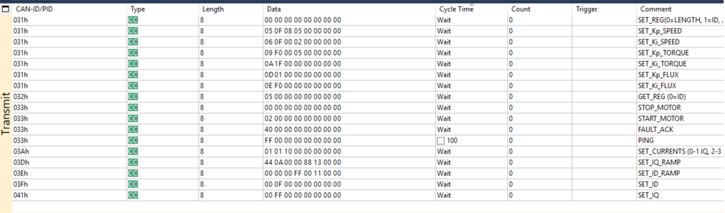
PCAN-View Transmit Message List
DEBUGGING
Test frame configuration used for manual command injection into the microcontroller during debugging.

Slide 22
Hardware setup and basic diagnostics verification
DEBUGGING
MCU to Dyno
✓
Physical layer & diagnostics (+0x40)
Confirmed via PCAN-View the continuous reception, every 100 ms, of the 10 telemetry packets generated by Send_Status.
✓
ACK/NACK on 0x10 ID and GET REG response on 0x11
Verified that the board responds to each command sent on 0x10 with 0xF0 (ACK) or 0xFF (NACK) or with the desired register value on 0x11.
Qui immagine rx pcan

Slide 23
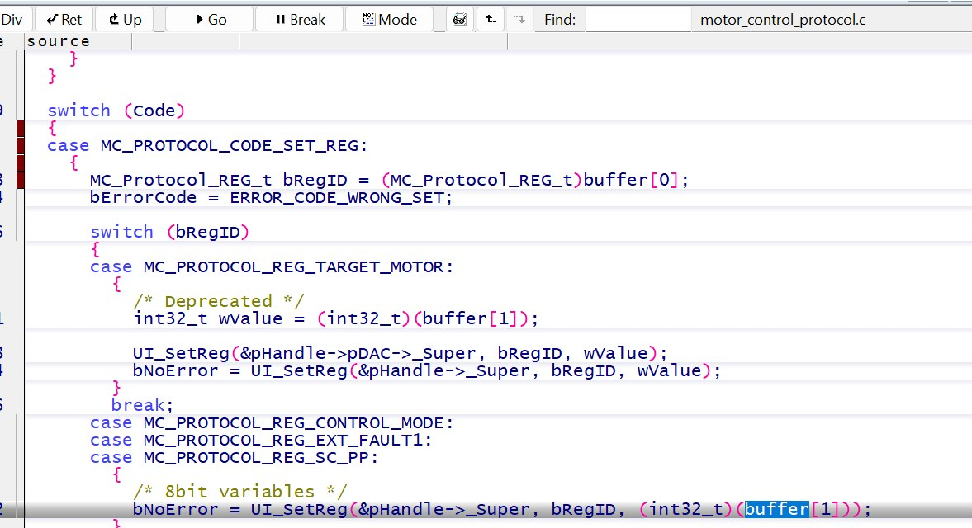
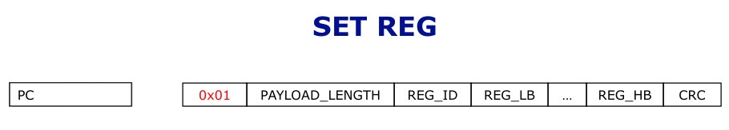
DW Protocol vs SR5E1 library Discrepancy
DEBUGGING
Debugging case study uncovering a mismatch between the DW Protocol specification and the SR5E1 library implementation.
1
SET_REG Transmission via PCAN-View
2
DW Specification Message Format
3
Debug Verification of Incorrect SET Handling
Conclusion: Byte 0 is not used for payload length, but directly represents the target register ID.
!
!

Slide 24
DBC file

Slide 25
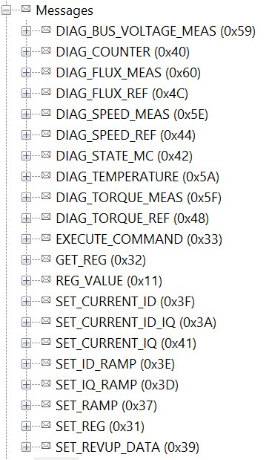
What is the .DBC file used for?
DBC FILE
The . DBC (CAN Database) file is the standard configuration file used in the automotive industry to describe the structure of the CAN bus. It acts as a dictionary that translates hexadecimal data into physical signals that can be read by software such as Vector CANalyzer.
CAN messages
The . DBC file defines:
CAN IDs of transmitted and received the messages
Length (DLC) of each message, expressed in bytes
Payload bit position, length, signed/unsigned type, scale factor and offset
Message Tree. DBC
Diagnostics (0x40 – 0x60): 10 periodic telemetry messages.
Motor Controls (0x30+): Registers, Speed/Flux Ramps, and Bitmasks.
MCU Responses: 0x10 (ACK/NACK) and 0x11 (REG_VALUE).

Slide 26
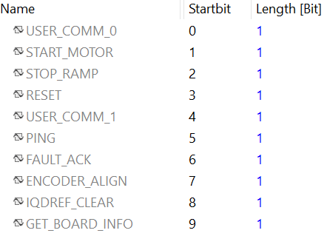

Examples of Parameters in CAN Messages
DBC FILE
EXECUTE_COMMAND (ID 0x33)
SET_RAMP (ID 0x37)
Transmits a bitmask organized on several bytes:
It carries two distinct physical parameters for the speed ramp:
Byte | Bit | Flag
0 | 1 / 2 / 3 | EXE_START_MOTOR / STOP_RAMP / RESET
0 | 5 / 6 / 7 | EXE_PING / FAULT_ACK / ENCODER_ALIGN
1 | 0 / 1 | EXE_IQDREF_CLEAR / GET_BOARD_INFO
Target Speed
Desired final speed (e.g. expressed in RPM)
Duration
Ramp duration, in milliseconds (ms)
EXECUTE_COMMAND signals
SET_RAMP signals

Slide 27
Library Alignment — +0x30/+0x40 Offset
DBC FILE
The message definition in the .DBC has been updated to closely reflect the architecture of the firmware library.
+0x30/+0x40 Offsets
New Command Management
The commands sent from the Dyno to the inverter maintain the offset convention already used by the library:
For commands not present in the initial library—such as the $I_d$ flux ramp (SET_ID_RAMP)—an unused CAN ID was assigned (avoiding conflicts with existing commands or 0x40+ telemetry) and defined in both the .DBC and the C firmware.
0x3B SET_CURRENT_ID
0x3C SET_CURRENT_IQ
CAN ID Map by Command Range
NEW
0x10 – 0x11
0x30 – 0x3A
0x3B – 0x3C
0x40 +
MCU Responses
Existing Commands
New Commands
Diagnostics
ACK/NACK, REG_VALUE
firmware library
SET_CURRENT_ID / IQ
Periodic telemetry

Slide 28

Response messages and structural correction
DBC FILE
Structural correction of the .DBC
REG_VALUE — ID 0x11
Response to GET_REG (0x32): The microcontroller transmits the 0x11 ID with the requested register value.
BEFORE
0xFF and 0xF0 were incorrectly defined as two distinct CAN IDs.
ACK / NACK — ID 0x10
AFTER
Each command received generates an acknowledgment: 0xF0 = ACK (successful), 0xFF = NACK (error).
A single unique ID 0x10; 0xF0 and 0xFF become payload values (signals) within the message.

Slide 29
CANalyzer & GUI Interface

Slide 30
Connection architecture: CAN Bus to Python GUI
CANALYZER & GUI
To evolve from manual validation (PCAN-View + TRACE32) to fully automated testing, Vector CANalyzer was integrated: a bridge between the Stellar-E microcontroller and the operator, hiding the hexadecimal register complexity behind a custom Python GUI.
Bus CAN
Stellar-E
CAPL +
file .DBC
Vector
CANalyzer
COM API
win32com.client
GUI
Python
CANalyzer
Python
It handles the timing of the CAN bus, the decoding of the . DBC file, and the execution of CAPL code.
It exclusively manages the user experience and the graphic rendering of the interface.
On startup, Python instantiates Vector.CANalyzer.Application, gaining direct access to the App.SystemVariables namespace.

Slide 31
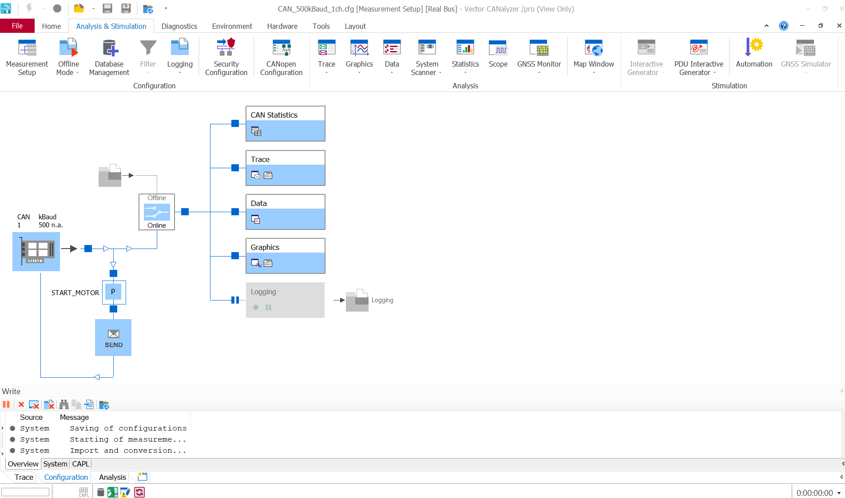
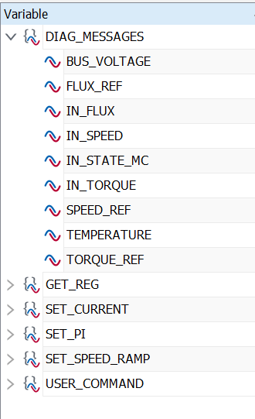
CANalyzer
CANALYZER & GUI
The following shows the Vector CANalyzer interface and the system variable namespace, with which the Python GUI communicates via COM API.
Interfaccia CANalyzer
System Variables

Slide 32
Flow of commands and telemetry
CANALYZER & GUI
Bus CAN → GUI
GUI → Bus CAN
Background capture: Firmware continuously sends the 10 telemetry packets (0x40+) and REG_VALUE response (0x11)
Graphical event interception (button/slider) → sysvar writing via COM API
1
1
CAPL event trigger on sysvar
2
2
Decoding in CANalyzer: CAPL on-message events decode frames via . DBC and update system variables
3
Security Control — Ready Flags for Multi-Parameter Commands: Unlocked Sending Only at Full Flags
Python reading and rendering: periodic polling via COM API, real-time updating of graphs and indicators
3
Assembly according to the . DBC and hardware transmission on the CAN bus
4

Slide 33
CAPL code
CANALYZER & GUI
CAPL events observe the system variables written by the GUI and, once the security conditions are met, assemble and transmit the frame on the CAN bus.
// CAPL: COMANDI
on sysvar SET_SPEED_RAMP::SET_RAMP { message SET_RAMP msgSpeedRamp; if (@this == 1 && is_finalSpeed_ready == 1 && is_durSpeed_ready == 1) { msgSpeedRamp.FinalSpeed_execrmp = g_finalSpeed_value; msgSpeedRamp.Duration_execrmp = g_durSpeed_value; output(msgSpeedRamp); } } // SET_REG: void send_pi_message(word reg_id, int val, int denom) { message SET_REG msg; msg.REGISTER_ID = reg_id; msg.REGISTER_VALUE = val; msg.REGISTER_VALUE_DENOM = denom; output(msg); }
// CAPL: DIAGNOSTICA on sysvar SET_SPEED_RAMP::SET_RAMP { on message DIAG_TORQUE_REF
{
@DIAG_MESSAGES::TORQUE_REF = this.DWord(0);
}
on message REG_VALUE
{
@GET_REG::K_num = this.GET_K_NUMERATOR;
@GET_REG::K_den = this.GET_K_DENOMINATOR;
}

Slide 34
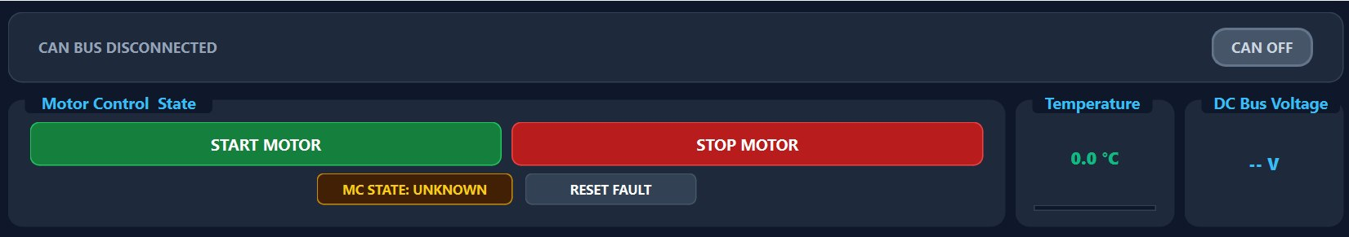
Motor Control Panel
CANALYZER & GUI
CAN Bus: Connection status displayed in the top panel Start Motor / Stop Motor: Motor start and stop commands Temperature / DC Bus Voltage: Real-time DC bus temperature and voltage MC State / Reset Fault: Controller Status and Fault Management

Slide 35
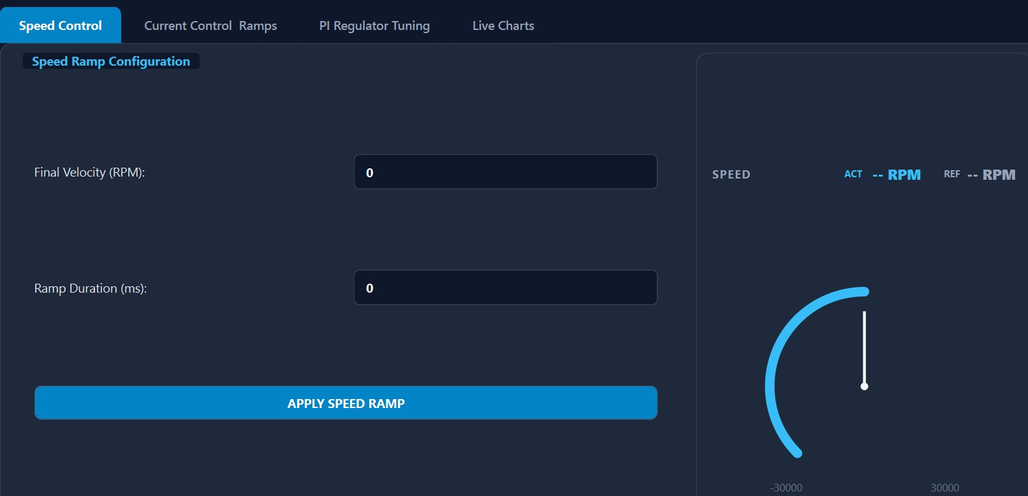
Tab Speed Control
CANALYZER & GUI
Final Velocity (RPM): Final speed SET
Ramp Duration (ms): Duration of the ramp SET
Apply Speed Ramp: Apply the set values to the Motor
Gauge: shows real-time reference value (REF) and current value (ACT)

Slide 36
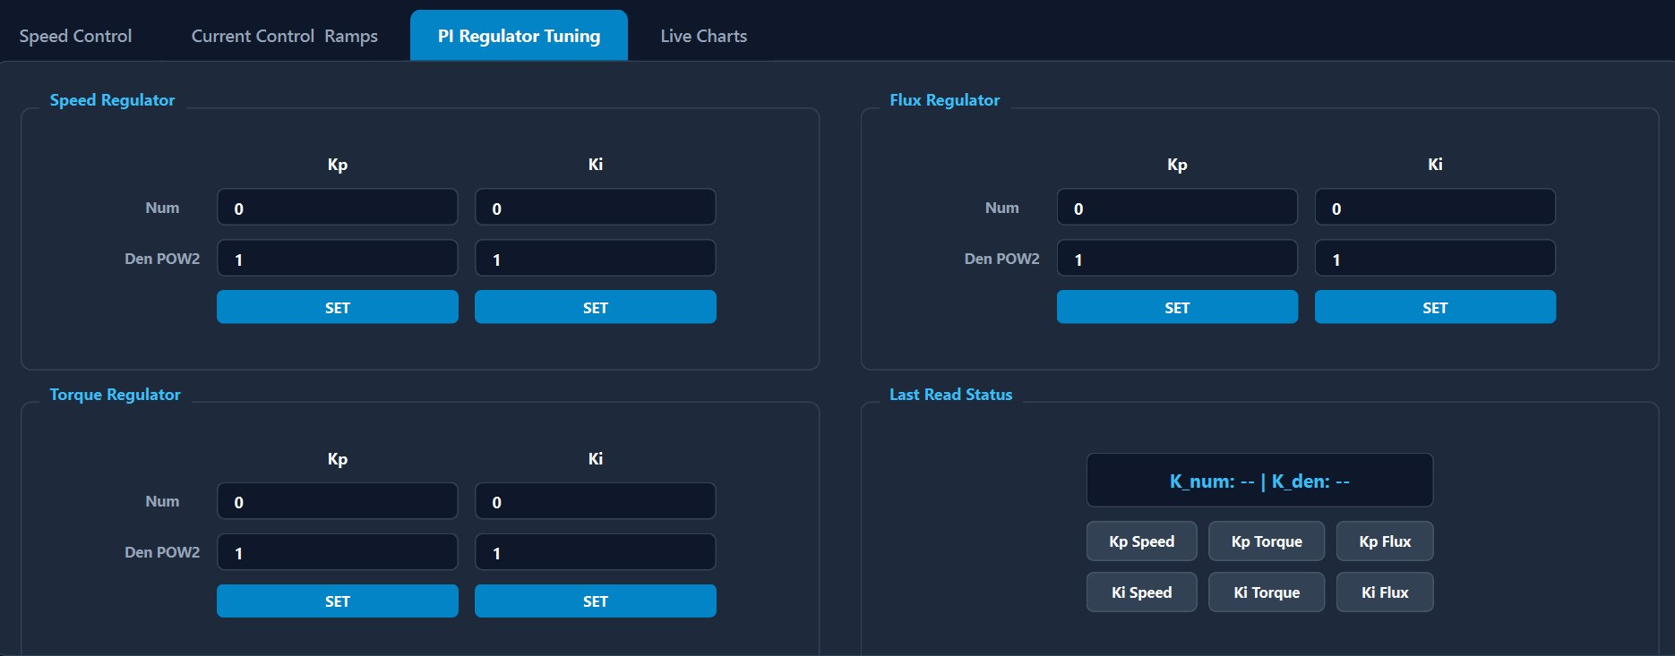
PI Controller
CANALYZER & GUI
Speed / Flux / Torque Regulator: Sections for the three control loops
Kp / Ki: proportional and integral gains of each ring
Num / Den POW2: numerator and denominator (power of 2) of each controller
Set: Apply set values

Slide 37
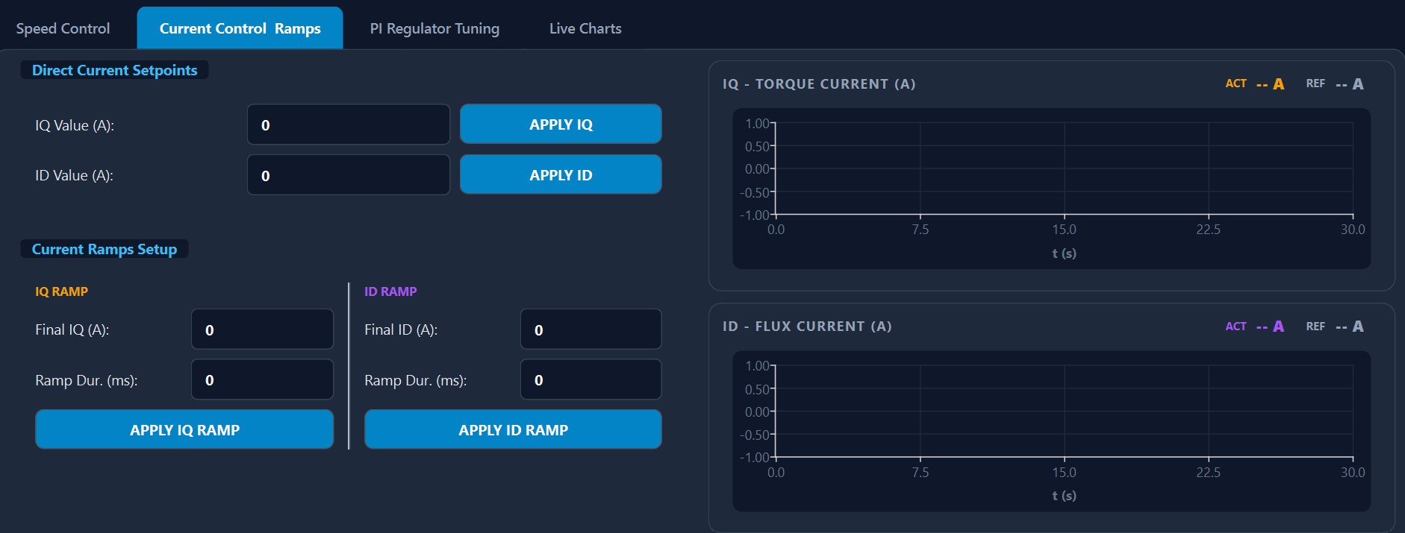
Tab Current Control
CANALYZER & GUI
IQ Value (A): Torque-producing current setpoint
ID Value (A): Flux-producing current setpoint
IQ Ramp / ID Ramp: Configurable independent ramps for each current component
Charts: Real-time plot of reference and measured currents over time

Slide 38
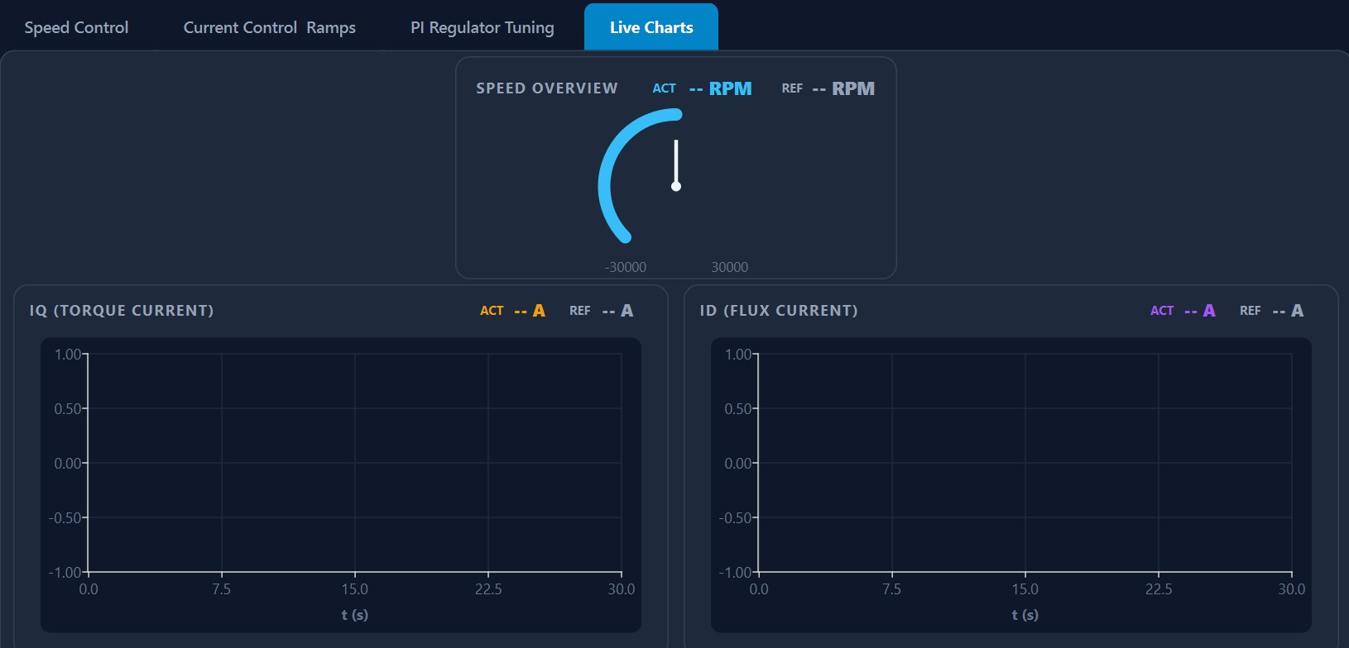
Tab Live Charts
CANALYZER & GUI
Speed Overview: Real-time speed gauge
IQ - Torque Current: Torque Current Graph
ID - Flux Current: Flux current graph

Slide 39
Conclusions and results
CONCLUSIONS
✓
CAN Library Validated
✓
New features
Resolved critical issues in ID mapping and registers decoding.
Independent I_d/I_q control, flux ramp, PI tuning via CAN.
✓
DBC Refactored
✓
GUI Development
Messages aligned to the library, correct ACK/NACK responses.
Python GUI + Vector CANalyzer for complete real-time testing.

Slide 40
Find out more at www.st.com

Slide 41

For further support in creating a PowerPoint presentation, including graphic assets, formatting tools and additional information on the ST brand
you can visit the ST Brand Portal https://brandportal.st.com

